Slide 1
Market Outlook of Lineｎ in Japan
for Sustainable Growth
Ｗｏｒｌｄ Ｌｉｎｅｎ Ｆｏｒｕｍ ｂｙ CELC
17ｔｈ～18th Ｓｅｐｔｅｍｂｅｒ 2018
ASABO
Japan Linen ＆ Ramie Association
Congratulations !
The success of World Linen Forum in Paris.

Slide 4
Economic Indicators in Japan
Source: IMF
（%Change from previous year) |  |  |  |  | Real GDP Growth Rate
 |  | 2007 | 2008 | 2009 | 2010 | 2011 | 2012 | 2013 | 2014 | 2015 | 2016
① | U.S. | 1.8 | -0.3 | -2.8 | 2.5 | 1.6 | 2.2 | 1.7 | 2.4 | 2.6 | 2.6
② | China | 14.2 | 9.6 | 9.2 | 10.6 | 9.5 | 7.9 | 7.8 | 7.3 | 6.9 | 6.7
③ | Japan | 1.7 | -1.1 | -5.4 | 4.2 | -0.1 | 1.5 | 2.0 | 0.3 | 1.2 | 1.0
④ | Germany | 3.4 | 0.8 | -5.6 | 4.0 | 3.7 | 0.7 | 0.6 | 1.6 | 1.5 | 1.8
⑤ | U.K. | 2.6 | -0.6 | -4.3 | 1.9 | 1.5 | 1.3 | 1.9 | 3.1 | 2.2 | 1.8
⑥ | France | 2.4 | 0.2 | -2.9 | 2.0 | 2.1 | 0.2 | 0.6 | 0.6 | 1.3 | 1.2
⑦ | India | 9.8 | 3.9 | 8.5 | 10.3 | 6.6 | 5.5 | 6.5 | 7.2 | 7.9 | 6.8
⑧ | Italy | 1.5 | -1.1 | -5.5 | 1.7 | 0.6 | -2.8 | -1.7 | 0.1 | 0.8 | 0.9

Slide 5
国内繊維産業の概況① Overview of Domestic Textile Industry (1)
国内生産の減少により、国内の繊維事業所数、製造品出荷額とも、1991年比で約1/4に減少。
Both the number of domestic textile establishments and the shipment value of manufactured product decreased to about 1/4 of those in 1991 due to the decrease in domestic production.
国内市場における輸入浸透率は増加し続けており、2016年には97.3%まで増加。
The import penetration rate in the domestic market has been increasing continuously.
It increased to 97.3% in 2016.
国内繊維産業の事業所数及び製造品出荷額
Number of domestic textile establishments and shipment value of manufactured products(× trillion yen)
国内市場における衣類の輸入浸透率
Import penetration rate of clothing in domestic market
（％）
_{94.3 95.4} 96.4 96.8 97.2
60,000
12.0
100
_{91.2} 93.3
（兆円）
87.7
97.3
90
79.7
50,000
10.0
80
70.1 70.6
77.0
70
62.1
76.1
_{67.9 67.5} 70.5
40,000
8.0
⁶⁰ 51.8
63.1
50
56.6
30,000
6.0
51.7
40
30
_{36.1} 38.7
20,000
4.0
輸⼊浸透率（数量（点数）ベース）
Import penetration rate (based on quantity (items))
20
10,000
事業所数（左軸） Number of establishments (left axis)
2.0
10
輸⼊浸透率（⾦額ベース）
Import penetration rate (based on amount)
出荷額（右軸）Shipment value (right axis)
0
1991
1992
1993
1994
1995
1996
1997
1998
1999
2000
2001
2002
2003
2004
2005
2006
2007
2008
2009
2010
2011
2012
2013
2014
2015
2016
0
1991
1992
1993
1994
1995
1996
1997
1998
1999
2000
2001
2002
2003
2004
2005
2006
2007
2008
2009
2010
2011
2012
2013
2014
0.0
出典：経済産業省「⼯業統計表」、総務省「センサス統計」、財務省
⽇本繊維輸⼊組合「⽇本のアパレル 市場と輸⼊品概況」
出典：経済産業省「⼯業統計表」
Source: Census of Manufactures of the Ministry of Economy, Trade and Industry
Source: Census of Manufactures of the Ministry of Economy, Trade and Industry, Census Statistics of the Ministry of Internal Affairs and Communications, Ministry of Finance
Japan’s Apparel Market and Overview of Imports of the Japan Textiles Importer’s Association
３

Slide 6
国内繊維産業の概況② Overview of Domestic Textile Industry (2)
国内のアパレル市場規模は、バブル期の１５兆円から１０兆円程度に減少する一方、 供給量は２０億点から
４０億点程度へと、ほぼ倍増している。
The supply volume has nearly doubled from about 2 billion to about 4 billion, while the domestic apparel
market size has decreased from 15 trillion yen in the bubble economy period to about 10 trillion yen.
衣料品の購入単価および輸入単価は、1991年を基準に６割前後の水準に下落。
The purchase unit price per clothing item and import unit price per clothing item fell to the level of around
60% on the basis of 1991.
国内アパレル供給量・市場規模の推移
Trends of domestic apparel supply and market size
(× trillion yen)
衣料品購入単価・輸入単価の推移
Trends of purchase unit price per clothing item and import unit price per clothing item
（億点）
(× hundreds of millions of items)
45
（兆円）
120.0
輸⼊単価指数
Import unit price index
国内供給量（左軸）Domestic supply volume (left axis)
国内市場（右軸）Domestic market (right axis)
18
40
15.3
16
100.0
購⼊単価指数
Purchase unit price index
100.0
97.1
35
14
30
12
80.0
85.1
69.0
72.3
25
10
64.8
10.1
10.5
60.0
20
8
59.7
53.5
59.8
15
6
40.0
10
4
20.0
5
2
0
1990
91
92
93
94
95
96
97
98
99
2000
01
02
03
04
05
06
07
08
09
10
11
12
13
14
15
16
0
0.0
1988
89
90
91
92
93
94
95
96
97
98
99
2000
01
02
03
04
05
06
07
08
09
10
11
12
13
14
15
16
出典：（国内供給量）経済産業省「生産動態統計」、財務省「貿易統計」
（国内市場）矢野経済研究所「繊維白書」
Source: (Domestic supply volume) Dynamic Statistics of Production of the Ministry of Economy,
Trade and Industry, Foreign Trade Statistics of the Ministry of Finance
(Domestic Market) Textile White Paper, Yano Research Institute
出典：購⼊単価=総務省「家計調査」，輸⼊単価=財務省「貿易統計」よりそれぞれ算出 ※１９９１年を「１００」とする
Source: The purchase unit price was calculated according to Family Income and
Expenditure of the Ministry of Internal Affairs and Communications, and the import unit price
was calculated according to Foreign Trade Statistics of the Ministry of Finance.
* In each case, the value of 1991 was set as 100.

Slide 7
国内繊維産業の概況③ Overview of Domestic Textile Industry (3)
⻑年の厳しい国際競争の中で、⽣き残った素材メーカー等は相応に強いものづくりの地⼒ を有し、織物輸出額は世界的に⾒ても⾼い⽔準にある。
Amid the challenging international competition of many years, the material manufacturers that have survived have
reasonably strong manufacturing grounds, and their export value of textiles is at a high level on a worldwide scale.
プルミエールビジョン（※）をはじめとした海外の⽣地⾒本市に多数の⽣地メーカーが出展す るなど、⽇本の⽣地は世界でも⾼く評価されている。
Japanese textiles are highly evaluated in the world, and accordingly, many Japanese textile manufacturers exhibit their
textiles at overseas textile fairs, including Première Vision(*).
⽇本の繊維業界の強み①
〜各国織物輸出額（2016）〜
Strengths of Japanese textile industry (1)
Textile export value of each country (2016)
⽇本の繊維業界の強み②
〜プルミエールビジョン国別出展数（2017年2⽉）〜
Strengths of Japanese textile industry (2)
Number of exhibits at Première Vision per country (February 2017)
輸出⾦額（億ドル）
Export value (× hundreds of millions of dollars)
500
506
700
625
600
Italy France Turkey England Spain Japan Portugal South Korea China Germany
400
500
60
61 ₅₈
400
46
300
40
⁴² 39 39
226
32 ₂₉
25
19
200
140
20
¹⁵ 13 12 12 12
112
85
8
6 6 5
100
63
56
37
33
32
0
0
China
South Korea Italy Istat Taiwan Turkey India
Hong Kong Germany (Customs)
Japan USA
Spain (Customs) France (Customs)
Thailand Indonesia Belgium
United Kingdom… Netherlands
Austria (Customs)
Portugal Czech Republic
出典： Global Trade Atlas
Source: Global Trade Atlas

Slide 8
Market Size
Apparel industry in Japan
10.5 trillion yen
15.3 trillion yen
95.5 billion USD （ １$ ＝ 110 yen）
80.7 billion EURO ( １€ ＝ 130 yen）
148.5 billion USD （ １$ ＝ 110 yen）
133.0 billion EURO ( １€ ＝ 130 yen）
2016
1991
27years ago
Each sector in Apparel

Slide 9
Outlook of the Final Linen Market in Japan
factor
Due to still continuing of deflation, particularly textile industry, &consumer’s declining buying power for clothing , apparel market is still weakness.
1
factor
Under such market environment for the apparel companies, as for the fiber material of clothing, only Linen and linen mixed are increasing considerably except all other fiber materials.
2
Japanese major apparel makers still have to reduce stores & employees.
On the other hand, mail-order & internet business are
increasing dramatically.

Slide 10
Imports into Japan of Linen yarn 2007 - 2018
Quantity: ton
Value : \1000
Source : Trade Statistics of Japan by Ministry of Finance

Slide 11
Imports into Japan of ASA(Linen,Ramie,Hemp)fabrics 2009 - 2018
Quantity: 1000㎡
Value : \1000

Slide 12
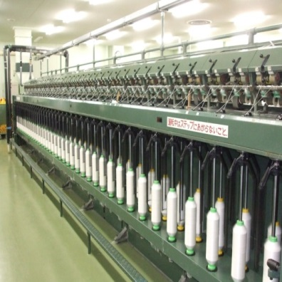
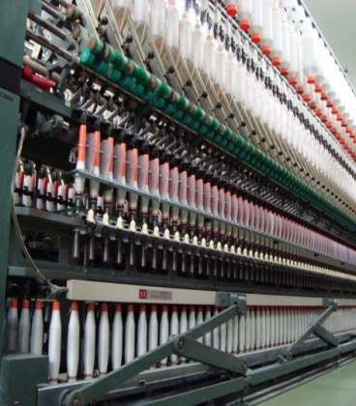
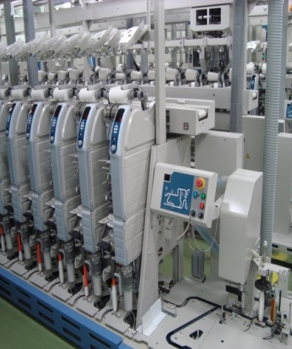
Fabric Report of Premiere Vision Paris (13-15 Feb. 2018)
会社名 ： トスコ株式会社 Company Name ： TOSCO CO., LTD.
会社紹介 Company Profile Established ： 5 Mar. 1918 Head Office ： Chuo-ku,Tokyo,Japan Tel. 03-3667-3321 Fax. 03-3667-3325 Japan Plant ： Mihara-shi,Hiroshima,Japan China Plant ： Kunshan City,Jiangsu,China Activities ： Manufacturing, processing of Linen, Hemp and Ramie fibers, President ： Keiji Nemoto (Director of ASABO)
理念 Company Vision
また、縄文時代から日本人は麻(苧麻、大麻)を手で紡ぎ、生活文化に取り入れてまいりました。
Also, Japanese people has taken fibers from RAMIE and HEMP and spun by hand from
Japanese ancient Jomon period and has incorporated that into our daily life.
トスコは、縦糸と緯糸の織りなすハーモニーにより、明日のライフスタイルをより豊かにしていく、新たな価値を紡いでまいります。
By harmony of warps and wefts in weaving using such fibers, TOSCO has been creating
new values in present –day, and it also enriches the people’s future life style.
主要設備
Main facilities ：4インチ乾式紡績設備一式（三原工場、昆山トスコ）
4-inch dry spinning unit at Mihara in Japan and kunshan in China
中国リネン湿式紡績メーカーとの取組み
and cooperate with Chinese wet spinning linen factory.

Slide 13
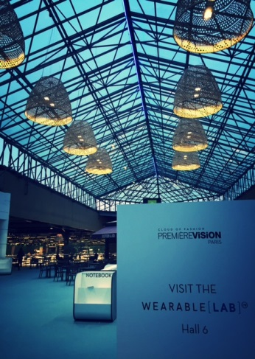
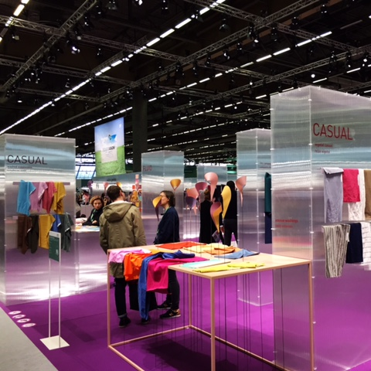
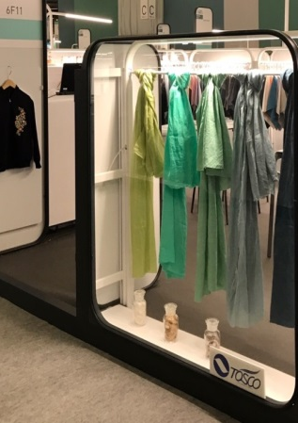
● ラミー糸は主に独自に開発した細繊種原料を 使用 Ramie yarns : Originally breed improved fine ramie fibers and organic ramie to our ramie yarns.
● 認証
Certification： GOTS (Organic Ramie)【Certificate No.C812367GOTS-03.2011】 ISO14001 【Certificate No. EC13J0043】
● プルミエールビジョンパリへの出展 Exhibition of Premiere Vision Paris
ｉ） 初出展 2015年2月より、毎年SSのみ出展
The first exhibition on Feb. 2015, exhibit only Spring & Summer Exhibition every year
ⅱ） 出展動機 The motive to exhibit
＊ 日本にも古来より定着した麻文化があり、メイドインジャパンの丁寧にもの作りした麻のテキスタイルを世界に紹介したい。
To introduce and spread our textile culture of Ramie and Hemp from ancient times and its modernized high-quality textiles
of Japan made to the world.
ⅲ） 2018年プリミエールビジョン パリ Premiere Vision Paris in 2018
概要 ：FORUMに展示された素材は次の5点 Summary 5 pieces displayed by FORUM : ①Linen denim ②Pigment denim ③High count Ramie yarn ④Ramie strech textile ⑤ Organic Ramie jersy ブース展示サンプルは１０５点のファブリック 105 pieces displayed at the booth
①Linen fabric 43pcs ②Ramie fabric 56pcs ③Ramie/Linen fabric 4pcs ④Japanese paper yarn fabric 2pcs
来場者等 ：来場会社数 約100社 Visitors etc around 100 companies
：サンプル要求件数 The number of demanded Fabric samples are 200～300 cases
Photographs
around
our booth

Slide 14
会社名 ： 株式会社ケンランド
Company Name KENLAND INC.
概要 About us
リネン・ヘンプ（フラット、サーキュラー、ワープ、レッグ）を日々進化させ、衣料、バス、キッチン、ベッド周りなどのライフスタイルグッズ、医療介護用品などの生活用品などの企画・生産
KENLAND INC. creates linen & hemp with knitting (flat, circular, warp, leg) and evolves day by day and commercializes lifestyle goods such as clothing, bathroom, kitchen, bedroom etc, and household goods such as medical nursing care products etc.
活動内容 Our activity
～草木染めの実践販売～Natural Dye
30年来社長大沼秀一自身が進めてきたプロジェクト。
年間約10-15種の植物やワイン・日本酒などを選び、そこから抽出した染料による染色
インディゴは、日本の伝統阿波スクモを使う作家（数社）とのコラボレーション（ジャパンブルー）
This is the project that the director of KENLAND INC., Shuichi Onuma, has been promoting for 30 years.
We select about 10-15 kinds of plants, wine and Japanese sake each year and dye linen with dye extracted from these items and commercialize it.
Our Indigo-dye collection collaborates with Japanese artists (several companies) using Japanese traditional Awa Sukumo.
The item that is sold is Japan Blue.
～神戸のシューズメーカーとのコラボレーション～
シープ、シカなど、軽く柔らかな素材（皮）をセレクトし、靴の内装にできる限りリネンを使用しています。靴底とインソールに二重に高反発材を使用し、足に優しい靴を作りました。
シューフィッターが測定し、インソールの高さを調整し、よりカスタマイズされた靴をご提案致します
Collaboration with shoe manufacturer located at Kobe in Japan.
We selected light weight and soft material (leather) such as sheep, deer and used linen as much as possible for the interior of the shoes. Also, we used double ply high repulsion material for the sole and insole and made shoes that were gentle to the feet.
The shoe fitter individually measures the size of each foot and also adjusts the height of the insole.

Slide 15
KENLAND’s MOVIE
※Please check attached file

Slide 16
TEIKOKU SEN-I CO., LTD.
Our activity

Slide 17
Our activity
FESTIVAL DU LIN 7-9 July 2017

Slide 18
Strength of the Linen market in Japan
Characteristic weather condition, hot & humid summer season.
1
Tradition of wearing vegetable fiber preference of luxury textile & fashion
2
3
Preference of luxury textile & fashion
4
Still big consumer market for Linen
Favorite of French & Italian fashion
5
By government-led campaign the “ Cool Biz” style as power-saving
6

Slide 19
Toward the FUTURE
For the sustainability growth of Linen
To differentiate from common commodity & FMCG (fast moving consumer goods), LINEN is a Gold fiber !
1
By using Japanese woven & knitted high-technology.
still alive excellent weavers & knitters in major source
2
To grasp the opportunity ！
From shrunk domestic market to expanded global market by Government subsidy & it’s several support
3
To yield the synergy effect ！
Premiere Vision, Milano Unica & Shanghai Intertextile.
4
To collaborate and yield the synergy effect among ASABO, CELC and CBLFTA！
5
To use the real traceability brand ！
Genuine brand label from CELC “European Flax”
6
Thank you for your attention !

